Slide 1


A primer on git
Graham Henke | Christopher Tull

Slide 2
Objectives
Introduction to git
Introduction to Github
Make changes to a project using git and Github

Slide 3
What is git?
"Git is a free and open source distributed version control system designed to handle everything from small to very large projects with speed and efficiency."
But...what does that mean?
Git is a way to continuously back up your work.
Git is a way to revert back to a working version of a project if your new changes introduce bugs or errors.
Git is a way for contributors to work independently on parts of a project and easily merge work back together.

Slide 4

git vs GitHub
git is a technology
GitHub is a service
Notes:
git can run locally. GitHub is a service, which allows code changes to be pushed to a server for backup, redundancy, and collaboration

Slide 5


Sort of like...
Money is a technology
A bank is a service
Notes:
Money allows for the store of value. Banks keep money safe, redundant, and easy to transfer from one person to another.

Slide 6


Installing git
Mac
Open "Terminal"
$ which git
If no result, download:
https://git-scm.com/download/mac
Complete installation
Windows
https://git-scm.com/download/win
Download
Complete installation
Open "Git Bash"

Slide 7
A few housekeeping commands
git config --global user.name "Your Name"
git config --global user.email you@example.com

Slide 8
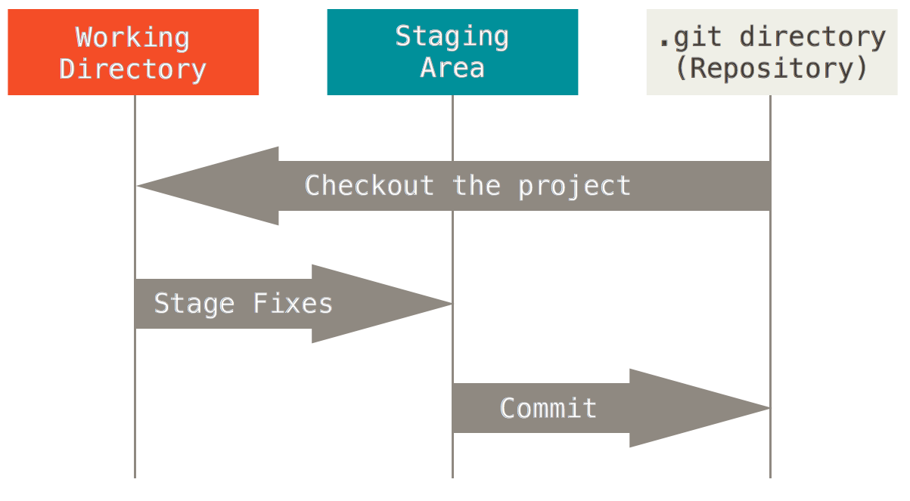
Git Workflow

Slide 9
Git basics
init - Creates a git "repository" (repo for short)
clone - Downloads a copy of a git repo
add - Adds files to a git repo for tracking changes
commit - Saves a record of changes to repo
push - Sends repo to a remote server
pull - Retrieves latest changes from server

Slide 10
Helpful commands
status - See what files are staged/unstaged for commit
log - View the change log of all commits

Slide 11
Slightly more advanced
branch - Create an independent branch of development
checkout - Change which branch you are on
merge - Combine one branch with another

Slide 12
Demo

Slide 13

Resources
git - the simple guide
Official git documentation
GitHub
tryGit

Slide 14
Thank you
Questions?

